Slide 1
House Price Analysis

Slide 2
Problem Statement
In the real estate market, predicting house prices is challenging due to the influence of multiple factors such as location, size, and amenities. The objective is to develop a machine learning model that leverages techniques like Lasso and Ridge Regression to predict house prices accurately. The process will involve thorough data cleaning to handle missing or inconsistent data, feature selection to identify key predictors, and model tuning to optimize performance. By using these advanced techniques, the model will provide precise price estimates and offer insights into the most important factors affecting house prices, helping buyers, sellers, and agents make informed decisions.

Slide 3
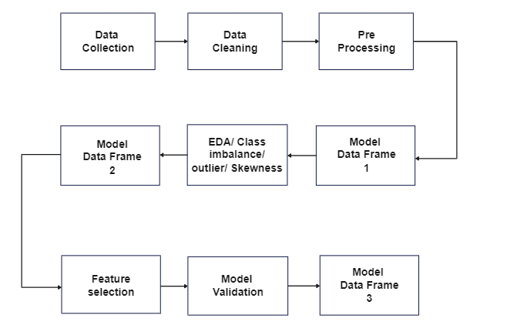
Flow Diagram

Slide 4
Data and Cleaning
Attributes
(1459 observations,81 attributes)
Dependent variable/Target Variable:
House Price
Missing Value Treatment:
Missing values treated in the following attribute: Garage_built_year
Data Type Conversion(Using Label encoder):
Data type of attributes like Building Class have been converted from object
to integer.
Duplicates:
No duplicates were found in the dataset

Slide 5
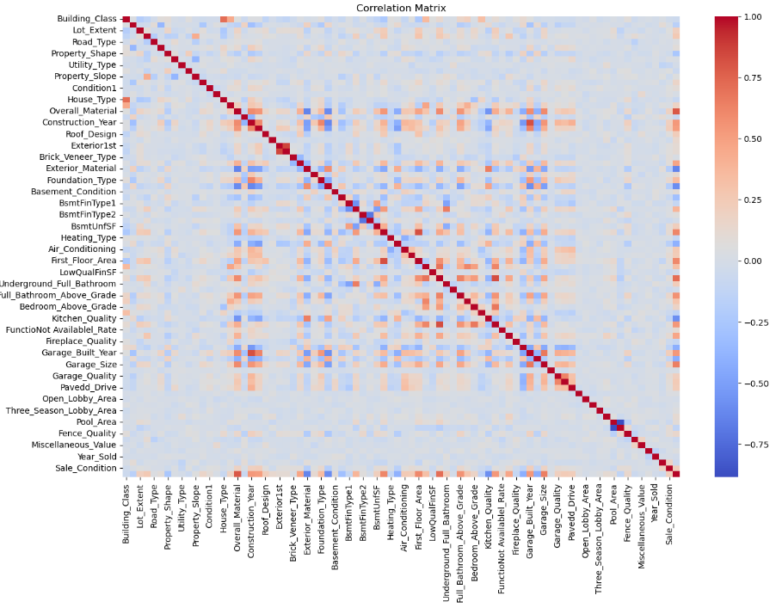
HEAT MAP for Correlation

Slide 6
Column Selection using Correlation Matrix
Columns which are highly corelated to the target variable are selected
Columns having Correlation less than 0.3 or -0.3 were dropped

Slide 7
Basic Data Frame
Model Name | R square Values | Adjusted R square value | Mse
Linear | 0.801359 | 0.798245 | 1.112633e+09
Lasso | 0.801359 | 0.798245 | 1.112633e+09
Ridge | 0.801359 | 0.798245 | 1.112633e+09

Slide 8
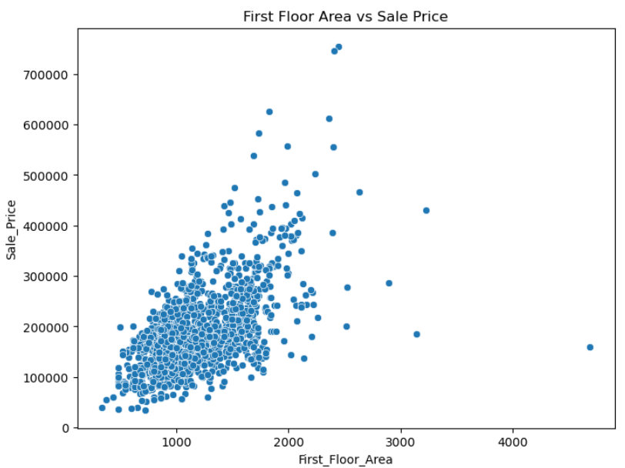
EDA
Scatter plot for first floor area vs Sale Price

Slide 9
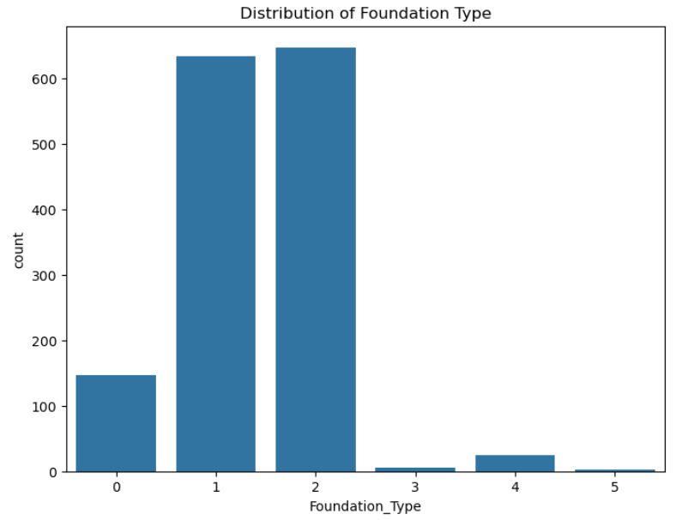
Distribution and count of foundation type in a Bar graph

Slide 10
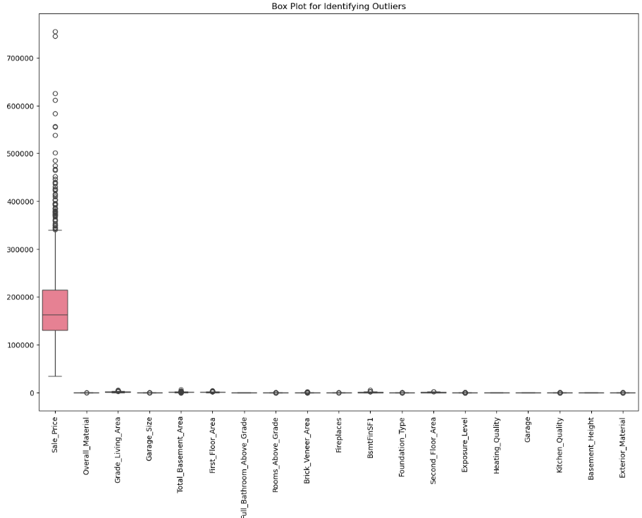
BOXPLOT
for
Outliers

Slide 11
Outliers & Skewness:
Numerical Columns containing Outliers were found using boxplot.
These columns were treated using their respective methods.

Slide 12
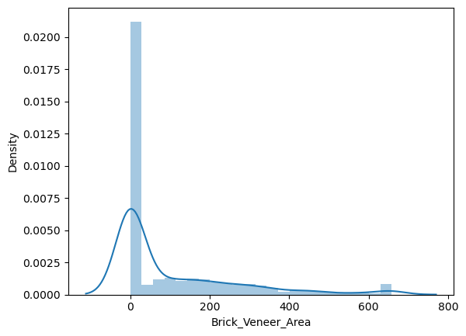
Skewness Treatment
Columns that needed to be treated for skewness:
Brick_Veneer_Area
Skewness was treated using Square root method

Slide 13
Data table after outlier and skewness treatment
 | Model Name | Rsquare values | Adjusted rsq | MSE
0 | linear | 0.821809 | 0.819015 | 1.048680e+09
1 | lassso | 0.821809 | 0.819015 | 1.048678e+09
2 | ridge | 0.821809 | 0.819015 | 1.048642e+09
All Models have the same output

Slide 14
Feature selection Using Lasso
Columns Selected are based on lasso model
Columns Having importance value less than 0 were dropped

Slide 15
Data Table after feature selection
Model Name | Rsquare values | Adjusted rsq | MSE
linear | 0.7932599318460 | 0.7916517549978817 | 1164014285.3473213
Since, each Model is giving the same output we can say than any model is compatible for the data
But after Feature Selection MSE has dropped
Final Conclusion: Feature selection using Lasso is best fitted model

Slide 16
Drawbacks
Outliers and skewed data: Some features, like Brick_Veneer_Area or Grade_living_area , can have extreme values, potentially impacting the performance of certain machine learning models.
Potential overfitting: The relatively small size (1460 rows) compared to modern datasets could lead to models that overfit without proper regularization.
Limited diversity: The dataset is specific region, so it may not generalize well to housing markets in different locations or countries.

Slide 17
Thank
You

